Slide 1

Movie Recommendation System Using R
-Group 4

Slide 2

Introduction
Movie recommendation systems use data mining techniques to analyze user preferences, viewing history, and movie attributes. By identifying patterns in this data, these systems help platforms like Netflix and Amazon Prime Video suggest movies that users are most likely to enjoy.
With the help of artificial intelligence, machine learning, and data mining, these systems personalize the user experience, make content discovery easier, and drive higher user engagement, benefiting both viewers and companies.
Top Research in Fortune Companies
Netflix: Advanced AI and data mining power its recommendation system, saving over $1 billion annually by reducing churn and boosting engagement.
Amazon Prime Video: Integrates recommendation systems with e-commerce to drive cross-sales and customer retention.
YouTube (Alphabet): Uses recommendation algorithms to maximize ad revenue and user engagement.

Slide 3
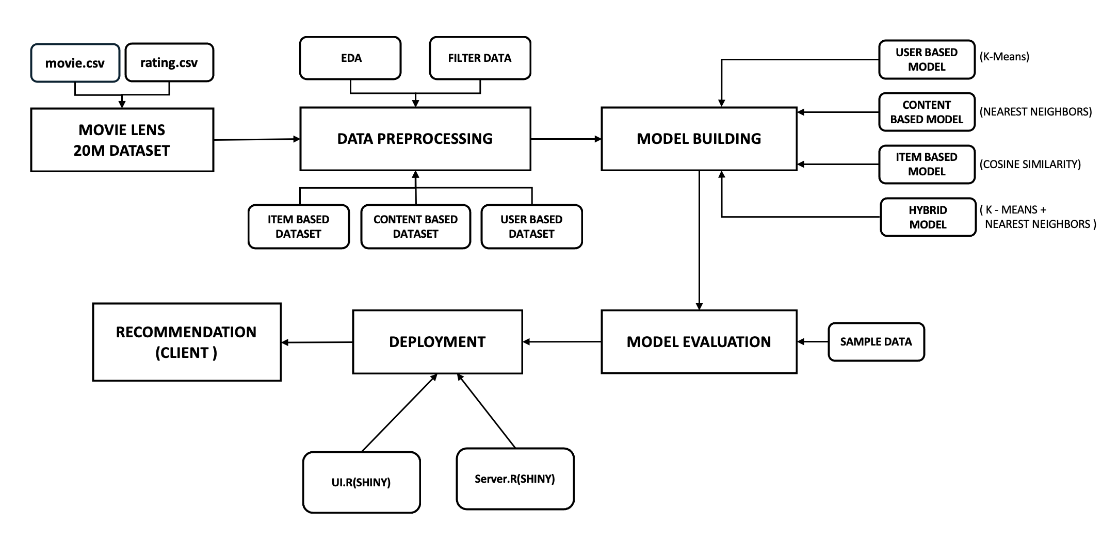
System Design (How it Works !!)

Slide 4

Data Preprocessing (Turning raw data into reliable insights)
Dataset Overview : Movie Lens 20M Dataset.
Focused on movies.csv and ratings.csv for generating recommendations.
Merged movies.csv and ratings.csv into a unified dataset.
Removed timestamp column to focus on movie features.
Created 3 custom recommendation datasets:
1. Content-based: 27,000 rows (one per movie), using features like genres and ratings (user information removed).
2. User-based: Utilized data from 2,000 users for personalized recommendations.
3. Item-based: Focused on item-item similarities for recommendations.
Preprocessing :
Removed Duplicates
Checking null Values
Feature Scaling
One Hot Encoding

Slide 5

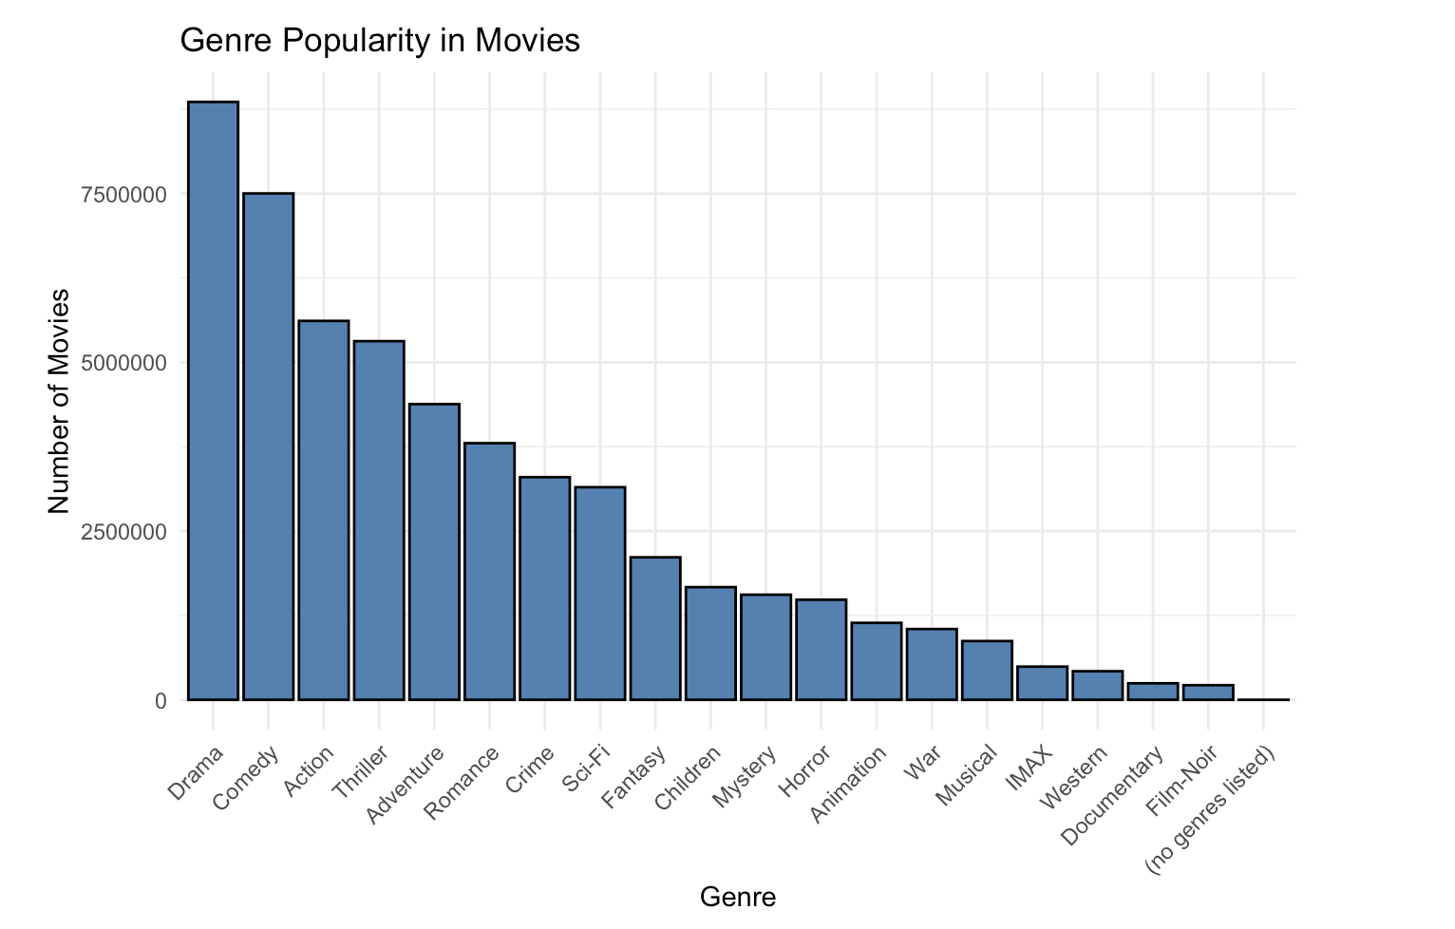
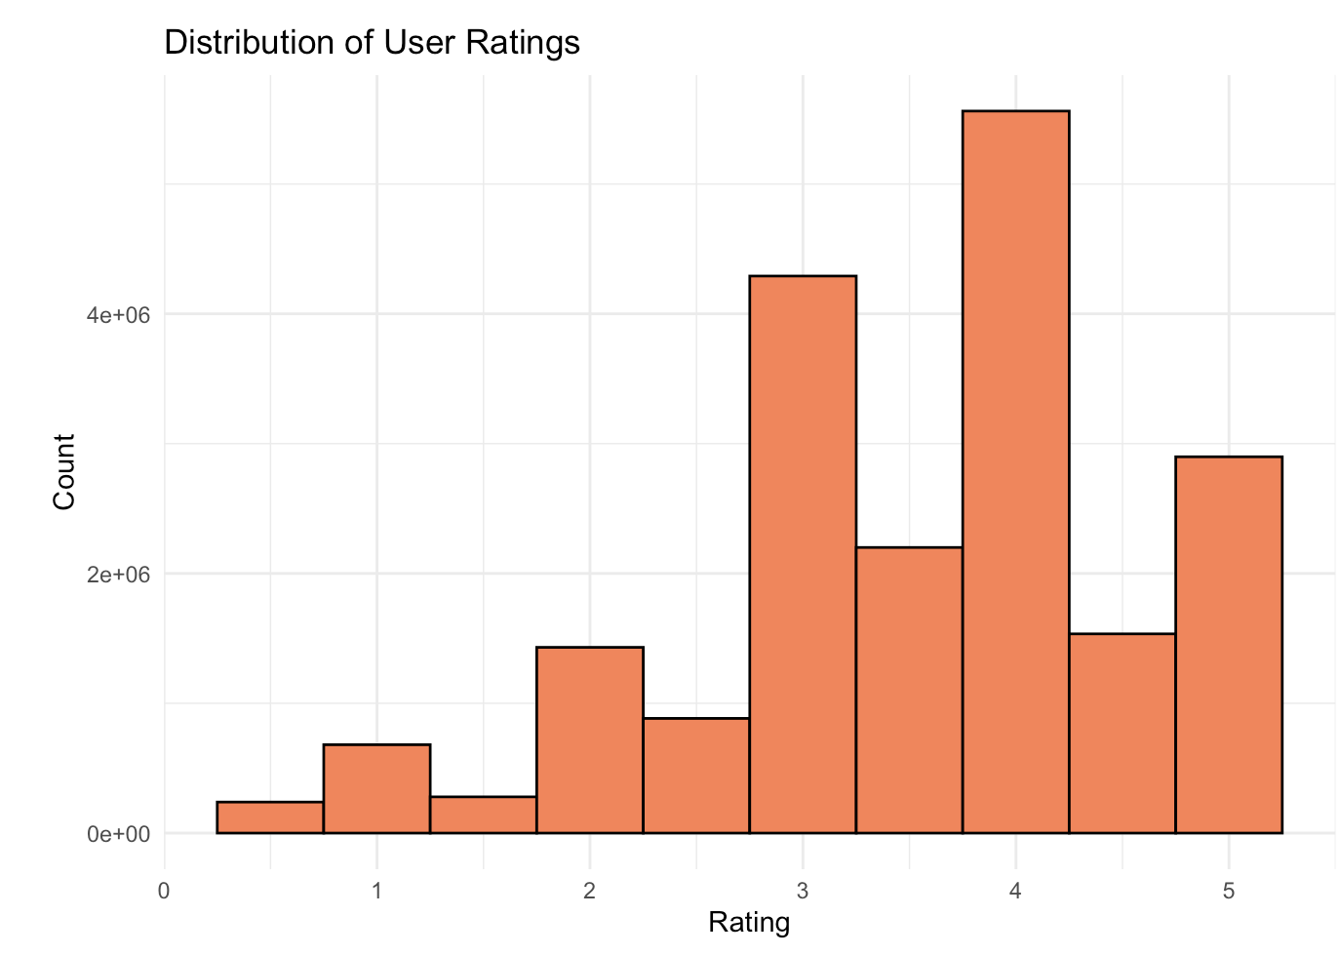
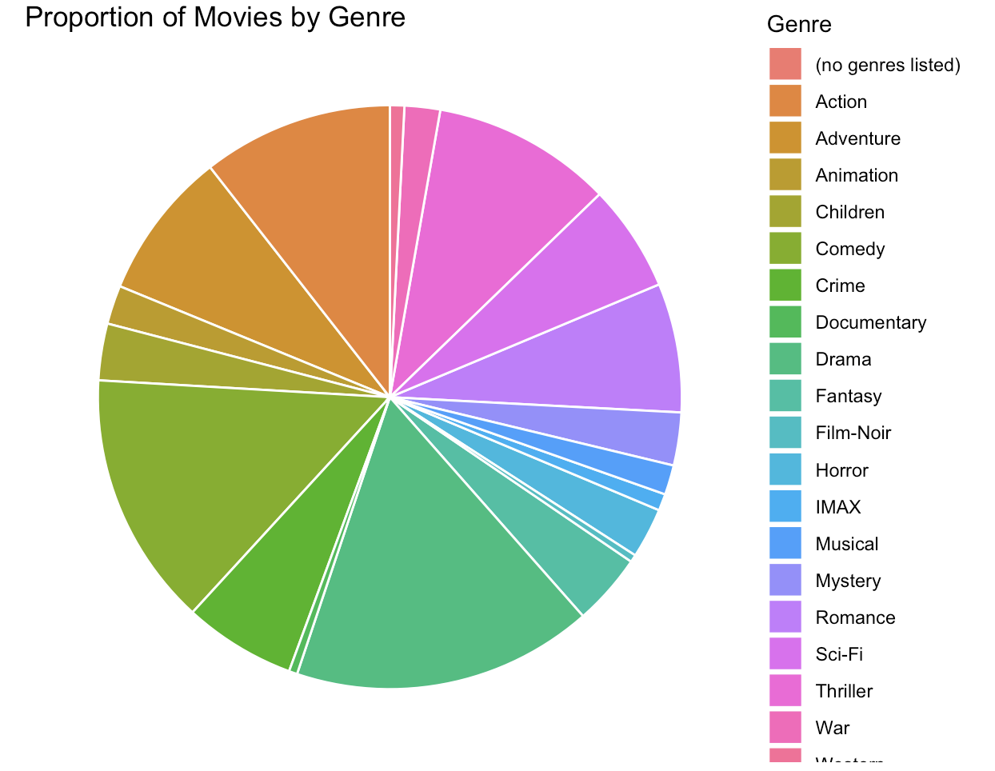
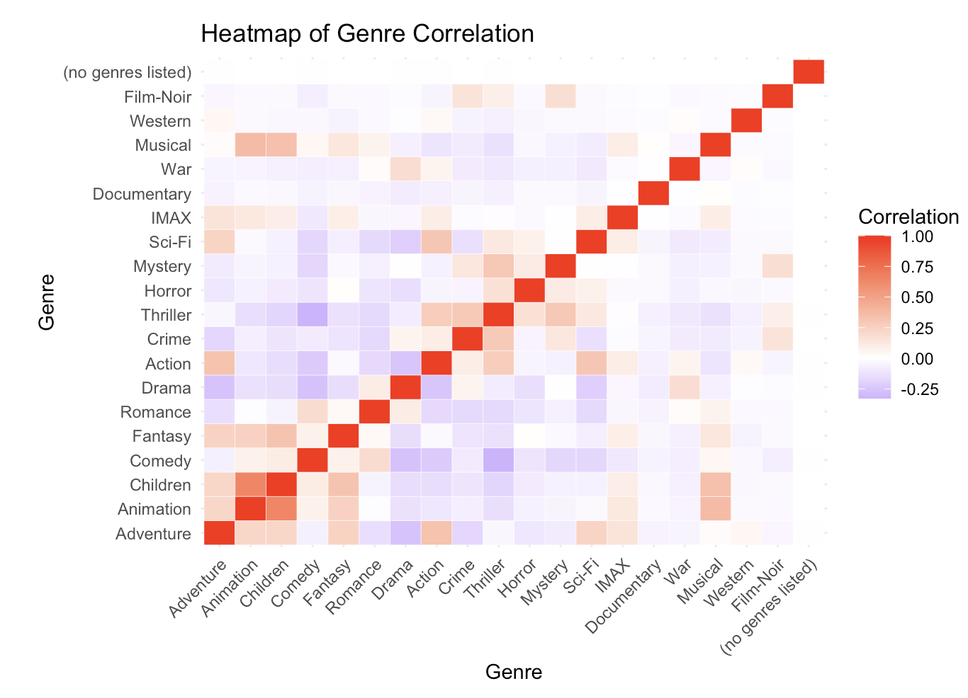
Exploratory Data Analysis

Slide 6
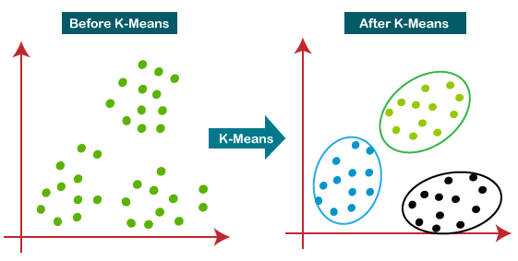
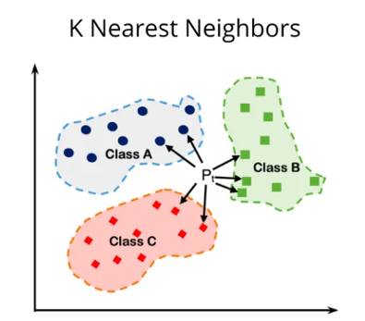
Model 1 : Hybrid Model (K-Means Clustering + Nearest Neighbors) .
Methodology
K-means :
Group movies based on genre and rating similarity.
Use K-Means clustering to form distinct groups.
Similarity Search:
Identify the input movie.
Calculate Euclidean distance between the input movie and others in the same cluster.
Recommend movies with the shortest distance.
* Accurate Recommendation
* Easy to Deploy

Slide 7
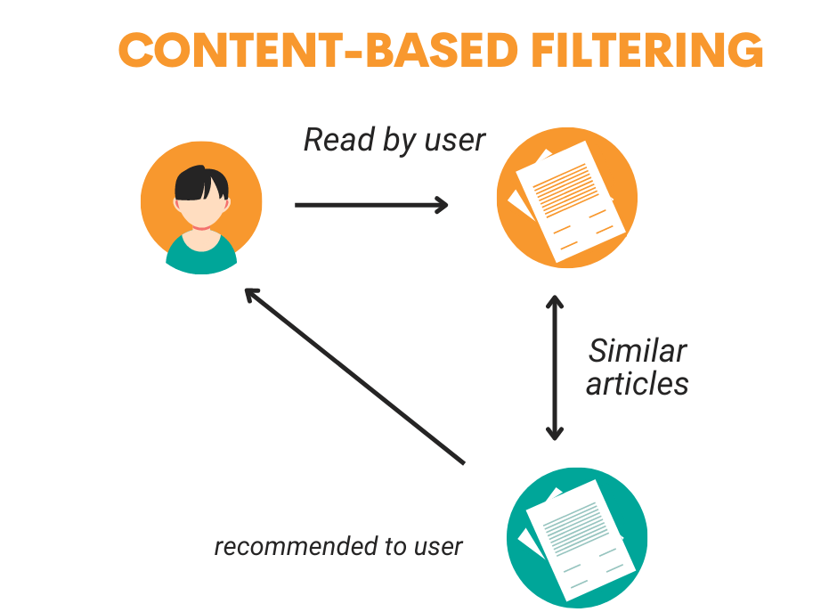
.
Model 2 : Content Based Filtering
Recommends movies based on their content (genres, ratings)
Nearest Neighbors Algorithm: Identifies similar movies using Euclidean distance.
Diverse Recommendations: Ensures recommendations are different from the input movie.
Interpretable Recommendations: Provides clear reasoning for suggestions.
Cold-Start Problem Solution: Recommends to new users without historical data.
*Recommends movies based on user preferences and content attributes.
*Provides clear and interpretable suggestions.

Slide 8
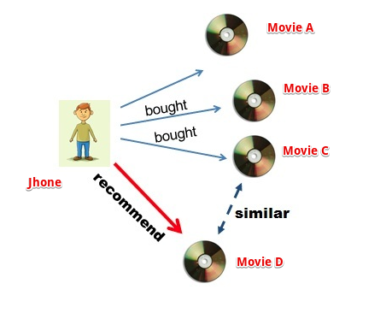
Model 3 : Item Based collaborative filtering
Recommends items similar to those a user has liked.
Compute item similarities using metrics like cosine similarity or Pearson correlation based on user ratings.
Identify the most similar items (neighbors) for each item from the similarity matrix.
Predict a user's rating for an unrated item using a weighted average of their ratings for similar items.
Recommend items with the highest predicted ratings to the user.
* Efficient for large datasets.
* Less personalized than user-based CF.

Slide 9
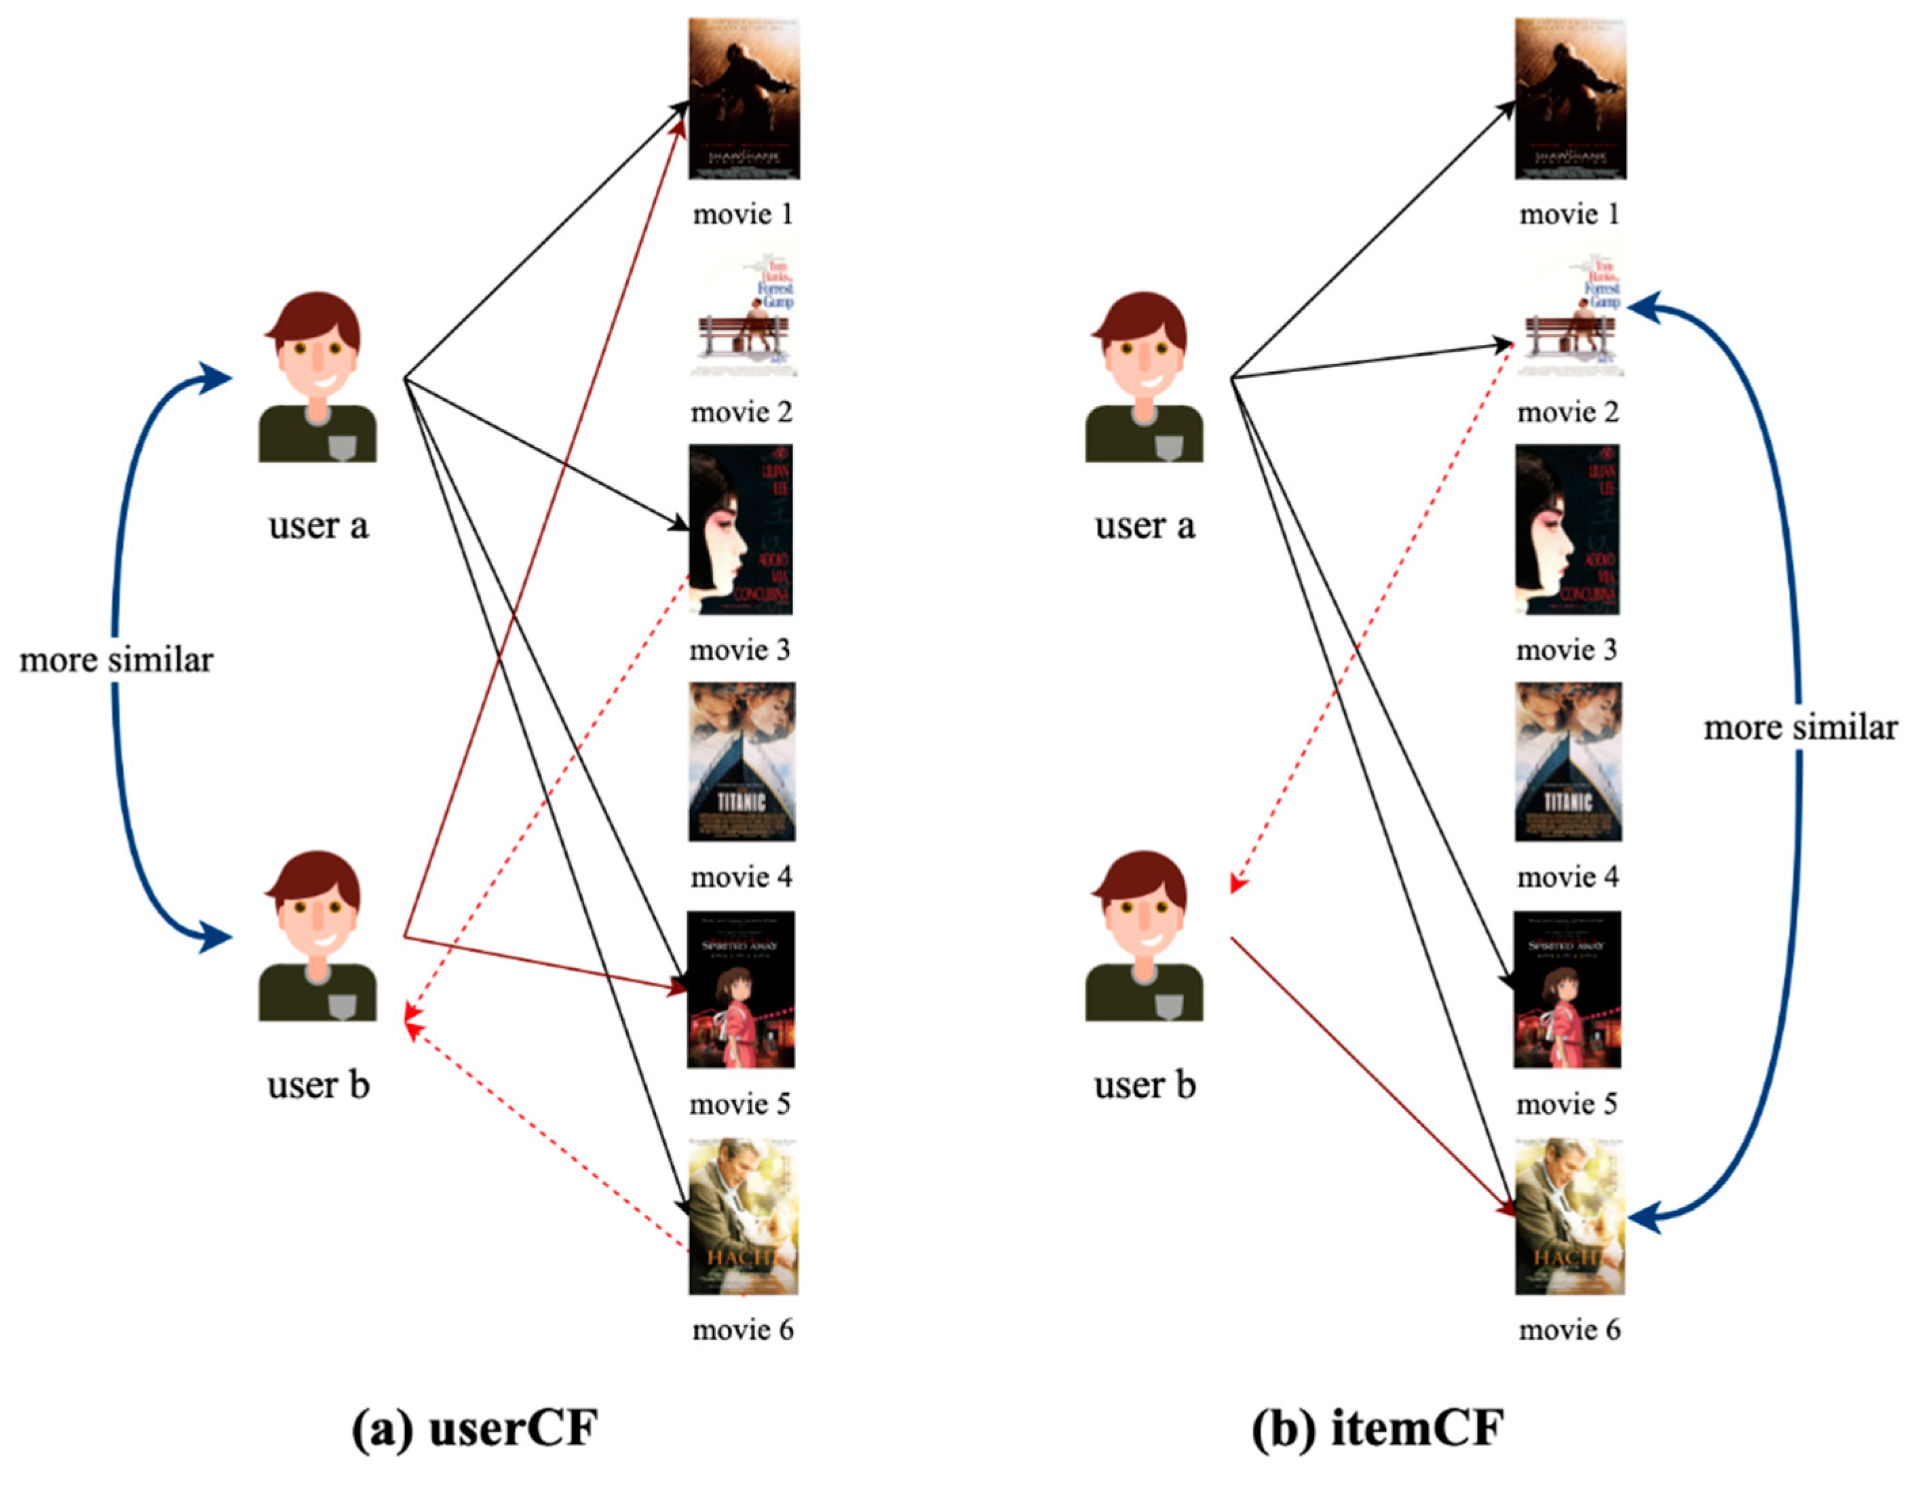
Model 4 : User Based collaborative filtering
Developed a User-Based Collaborative Filtering system for movie recommendations.
Due to complexity, we only took 2000 user data to train the model.
Merged ratings with movie metadata and prioritized popular movies using average ratings and counts.
Applied K-Means clustering to group users with similar preferences and identified the nearest cluster for each target user.
Generated recommendations by aggregating ratings from users within the same cluster, focusing on unrated movies.
* Provides personalized recommendations based on similar users' preferences.
* Effectively handles the cold-start problem for new movies.

Slide 10
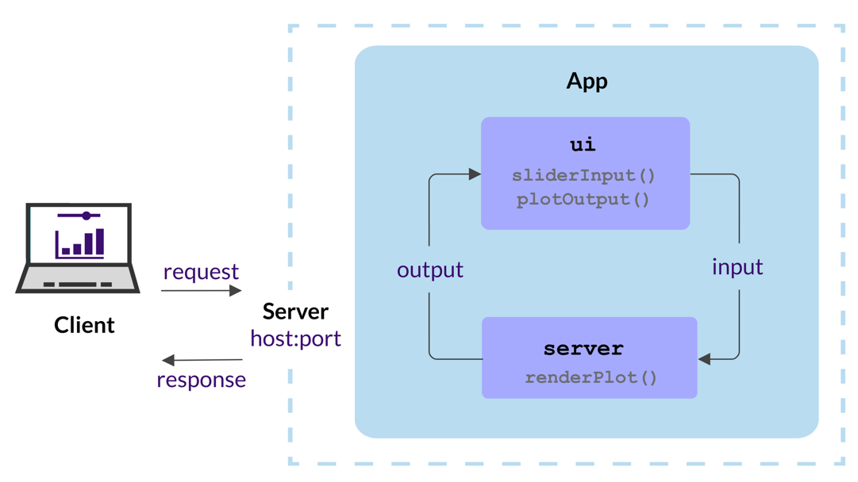
Model Deployment
Shiny deployment makes it easy to turn R applications into interactive web apps that users can access from any browser. It ensures a seamless experience with responsive design and fast, real-time updates.

Slide 11
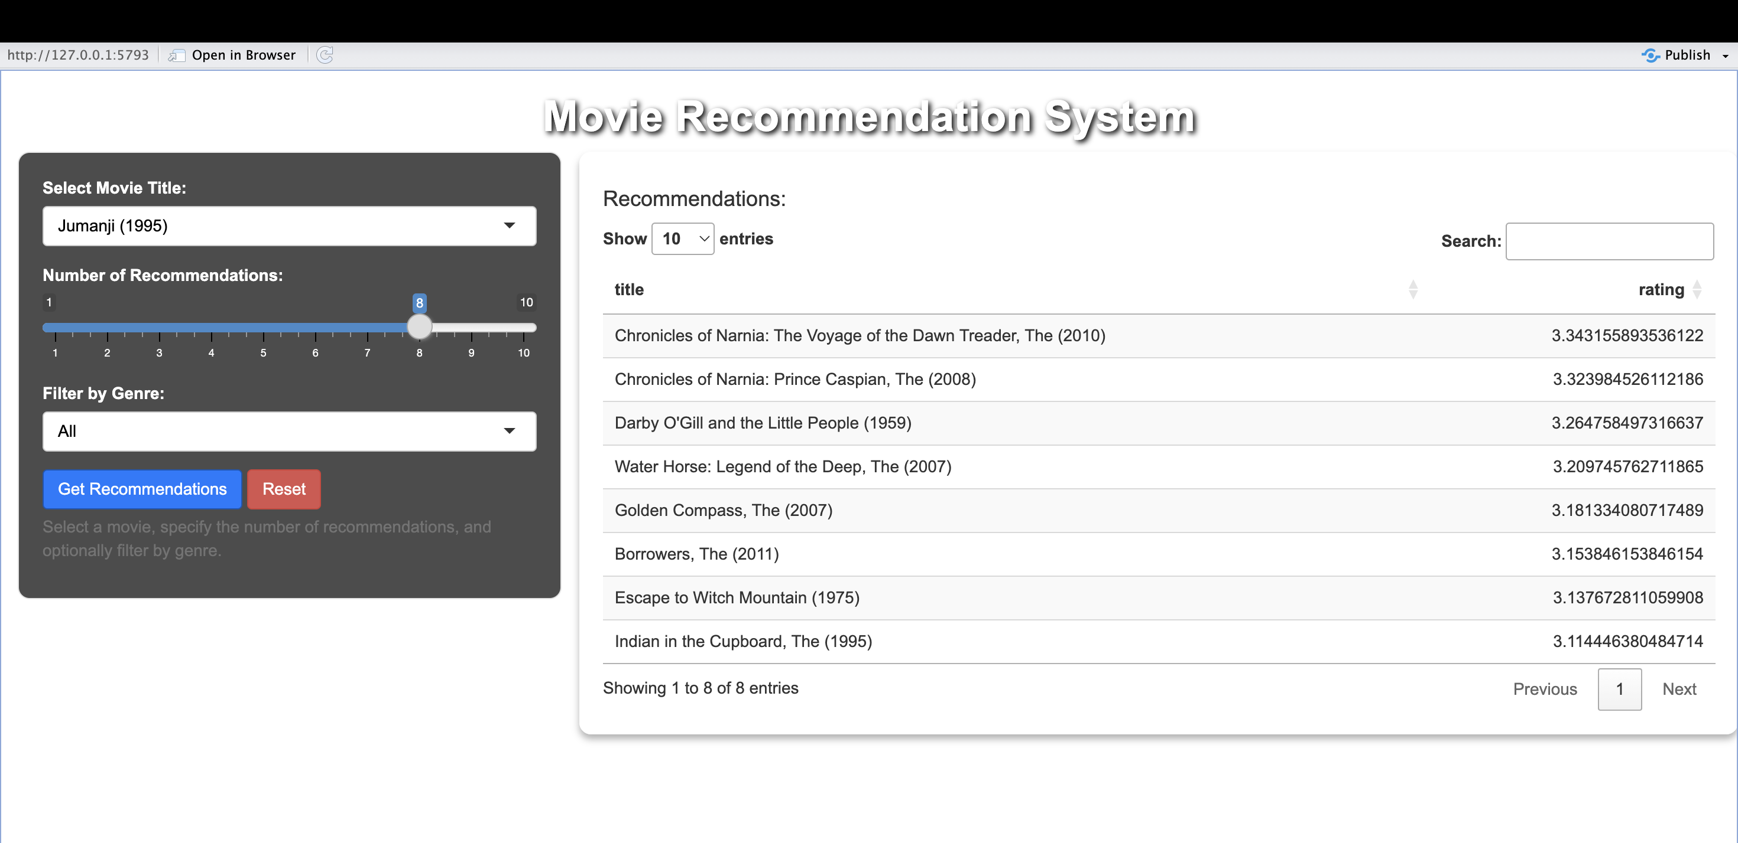
Evaluation
Model 1 is the best performing model with high realistic outputs and logic contains in each recommendation.
Why Model 1? Easier to Deploy and Better Result

Slide 12
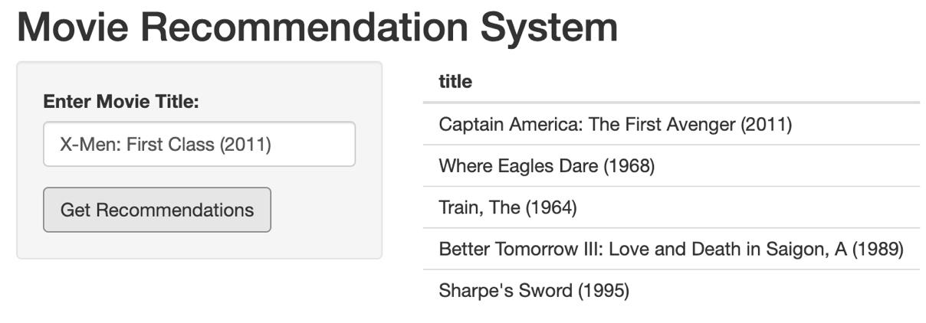
Evaluation
"X-Men: First Class (2011)" was clustered with action, sci-fi, and adventure films. Recommendations:
Captain America (2011): Similar genre/year.
Where Eagles Dare (1968): High-rated action-adventure.
The Train (1964): Tactical historical action.
A Better Tomorrow III (1989): Intense action-drama.
Sharpe's Sword (1995): Action-war with teamwork themes.

Slide 13
Resources
GitHub: https://github.com/RohithAnnapureddy26/Movie-Recommendation-Sysytem-using-R
Demo Video : https://drive.google.com/file/d/1yntvbi3fPlEl5NXx5YgGYd2WC9SKesUB/view?usp=sharing

Slide 14


